Slide 1
KOKO Referrals
Working scope document

Slide 2
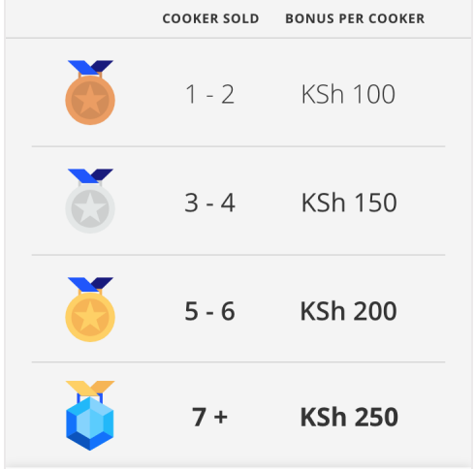
Goal Incentivise customers to sign up up other customers to KOKO | What does success look like? 50% of new KOKO customers are acquired via the referral programme | Metrics # referrals made # of ambassadors (diamond status users | Fuel bought by referees Revenue from referees # of referees who buy a stove # of referees who become regular fuel customers
Big Picture Core functionality for inviting friends exists in MyKOKO app. The ambition is to increase the level of incentivisation through: Introduction of new features - view commissions earned, access to sales materials, view of how referees are progressing towards buying a stove Gamification (ambassador status) Ability for referrers to contact their referees Current incentives for referrers: Bronze (KES 100) KOKO Credit Silver (KES 150) KOKO Credit Gold (KES 200) KOKO Credit Diamond (KES 250) M-Pesa Incentives for referees - TBC |  | Channels Majority of functionality will sit in MyKOKO One screen with status & invitation code will be available in the KP | Marketing How will we advertise the referral programme? Target launch date What’s the roll out plan? What additional sales content needs creating?
 |  | Cost Model TBC
 |  | Resources required Customer Service resource Marketing team resource to launch and monitor programme / create resources Product and Dev | Risks We don’t get enough referrers on board Increased complexity in the app Referrals don’t yield good customers

Slide 3
New requirements
All customers | Ambassadors
Incentivise customers | View referrals | Access to sales material
View my referral status (bronze, gold etc.) | View list of referees | Share videos on how great KOKO is with potential new customers
View how many stoves I have sold | View status for each referee (stove bought, savings progression) | Share pdfs and brochures on how great KOKO is with potential new customers
View my commissions | Able to send generic messages to my referees to encourage them to keep saving for a stove | View selling tips and tricks and other useful KOKO USP content
Notifications on how far to diamond status | Able to customise generic messages to my referees | Process for uploading sales content to the app
Notification when I hit diamond status | Schedule when customers receive messages encouraging them to keep saving | Map of stove locations**
Transfer commissions to customers | Customer Services able to approve messages to customers | Availability of stove locations**
**Dependent on other features which don’t exist yet so will need to be incorporated later
Blue = Phase 1 scope

Slide 4
User selects Invite friends on Homescreen
# stoves sold?
Invite friends screen
0
Bronze screen
1-2
3-4
Silver Screen
5-6
Gold Screen
Invite friends
AMBASSADOR FUNCTIONALITY
= 7 or more
Ambassador Screen
See friend’s progress
Enter social media UI
Send follow up messages
Select channel
Schedule SMS
Select SMS recipients

Slide 5
Paying out referrals bonus’
Currently are handled manually but long term we need to settle these automatically via the ERP.
Customer enters invite code of referrer
Customer buys stove
Bonus is attributed to referrer in KOKO Core
Has user sold 4 stoves or more?
Customer is paid 200 Ksh MPESA credit
No
Transaction recorded in Odoo
Customer is paid 250 Ksh MPESA credit
Yes
Notes:
Need to know if the stove has bought
Need to track status to know what to pay

Slide 6
High Level Architecture
MyKOKO
Credits customer account (KOKO credit / MPESA cash)
KOKO Core
KSPS
API - what referral level is customer on
Bonus
amount + type
API - successful referrals, commissions earned

Slide 7
Risks & Questions
ERP module will not be in place by the time we want to launch referrals functionality -can we pay out commissions manually? How many are we expecting?
Are we going to continue using KOKO Core to link codes entered by new customers with referers?

Slide 8
Payment failures
No
Yes
KOKO Core triggers commission payment
Payment fails
Negative response received from Safaricom
Failed payment and reason logged in KOKO Core
SMS message sent to users
Customer calls Customer Services
Customer Services agent checks transactions
Payment failed?
Payment failed?
Notes:
Need to know if the stove has bought
Need to track status to know what to pay

Slide 9
Customer calls Customer Services because they did not receive their commission
Customer Services agent checks transactions
CS agent instructs to make a MPESA manual payment
Finance approve and make the payment
Finance create manual journal entry for Odoo
Yes
Promoter gets MPESA?
CS agent can trigger payment to T-Kash or Airtel money
No
Payment failed?
Customer calls Customer Services
Customer Services agent checks transactions
Payment failed?
Payment failed?
Customer calls Customer Services
Customer Services agent checks transactions
Payment failed?
Payment failed?

